Slide 1
The Speed of Trust
Notes:
The one thing that changes everything - Stephen Covey

Slide 2
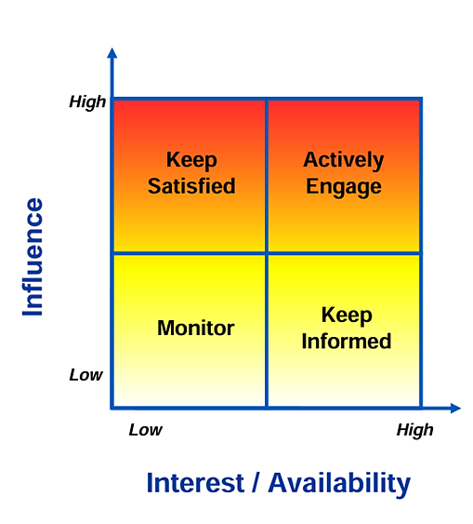
Stakeholder Map – Journey Continues
Notes:
Real world example must be given on why trust is important –
There is one thing that is common to every individual, relationship, team, family, organization, nation, economy and civilization throughout the world — one thing which, if removed, will destroy the most powerful government, the most successful business, the most thriving economy, the most influential leadership.
On the other hand, if developed and leveraged, that one thing has the potential to create unparalleled success and prosperity in every dimension of life
That one thing is trust.

Slide 3
Trust Why trust is important?
Notes:
There is one thing that is common to every individual, relationship, team, family, organization, nation, economy and civilization throughout the world — one thing which, if removed, will destroy the most powerful government, the most successful business, the most thriving economy, the most influential leadership.
On the other hand, if developed and leveraged, that one thing has the potential to create unparalleled success and prosperity in every dimension of life

Slide 4
Trust is the Performance multiplier
S x E = R
(Strategy x Execution = Results)
(S x E) _______ = R
(Strategy x Execution) = Results.
Trust
Trust
Notes:
How do you achieve results that you want ? – you want a strategy and you need to execute the strategy but is this enough ?
“Your strategy may be perfect.
Your execution may be strong.
But results only explode when trust comes in.
Trust is not an addition … it’s a multiplier.
Even if strategy and execution is 10/10,
But trust is zero, Result will become zero” Clear example that will bring out concept of trust – specific to ISE & personal contrast example
Think of a cricket team preparing for a world cup.
Great strategy from the coach + world-class execution from the players
What if the players don’t trust themselves or don’t trust each other, what happens ?
Drop catches… misfields….run-out confusion …fear of failure etc Examples wrt ISE Earlier AE engagement. AEs loop you in sooner because they trust your qualification rigor; you shape deals before they ossify, increasing winnability.
Smoother handoffs to delivery and services. Clear, trusted scoping avoids rework, change orders, and post-sale noise — protecting margin and customer satisfaction.
Faster approvals from managers or finance. Trusted SEs get greenlights on custom configs and special terms more quickly because their proposals are reliable.
Asset reuse across pods. When your sizing guides and demo scripts are trusted, teammates reuse them, multiplying your impact beyond your own pipeline.

Slide 5
The 2 Pillars of Trust
1. Foundations of Trust
2. Behaviors of Trust
Notes:
Now that we understand why trust matters – it multiplies performance – the ext question is
How do we actually build trust?
Because trust doesn’t appear magically. Its not luck!
Its built on two very specific pillars.
Every leader, every team, every customer relationship is based on these two things.
Foundations of Trust – what people believe about you
Behaviours of Trust – what people see you doing if even one pillar is weak, the whole structure become shaky

Slide 6
Foundations of trust

Slide 7
Rate yourself from 1–5 :
INTEGRITY
1. I consistently make choices that reflect my values, even when no one notices.
2. I follow through on commitments even when my motivation drops.
INTENT
1. People can feel that my actions come from a place of goodwill, not self-interest.
2. I prioritize doing what is right for the relationship, not just what is convenient for me.
CAPABILITIES
1. I intentionally push myself to grow instead of relying only on my current strengths.
2. I take responsibility to stay relevant by learning new skills before they are required.
RESULTS
1. I deliver the outcomes I commit to, even when obstacles arise.
2. People depend on me because I consistently turn intentions into measurable results.
Notes:
2 question on each foundation change results second questions More ques for Results 1. I move priorities from backlog to done, creating visible momentum others can rely on.
2. I navigate constraints and still deliver, adapting without lowering the bar.

Slide 8


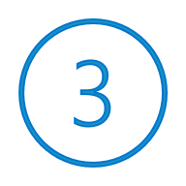
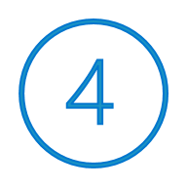
Foundations of Trust
Character
- Do I do what I say?
Integrity
(Consistency, Modesty and Courage)
Intent
(Motive, Agenda and Behavior)
- Do I mean well?
Competence
Capabilities
(Talent, Skill, Knowledge, Style)
- Am I improving?
Result
(Past ,Current and Anticipated Performance)
- Do I get things done?
Notes:
Connect with relationship trust – tie it to behavior what are the behavior that you look in others to trust them or what behaviors you demonstrate to gain trust?

Slide 9
Relationship Trust
Notes:
Blue lock example – KING ? Lead with - Activity 2 questions on each behaviour?

Slide 10

Relationship Trust - Behaviours
Be Honest & Transparent
Say the truth clearly, avoid hidden agendas, and make your intentions known.
Eg – Instead of saying vague updates like “It’s in progress,” you say : “I’m 70% done; I will finish by tomorrow noon.”
Show Respect & Loyalty
Treat people well, acknowledge their contributions, and speak respectfully both in front of them and behind their back.
Eg – In a meeting, you say:“This idea came from Priya — she deserves the credit.”
Deliver & Own Outcomes
Do what you say you’ll do — and take responsibility when you don’t.
Eg – If you miss a deadline, you don’t blame workload. You say:“I didn’t plan well. I will fix it and update you by 4 PM.”
Actively Listen & Clarify
Understand before responding. Clarify expectations early so trust isn’t broken later.
Eg – Before starting a task:“Just to confirm — you need a 5-slide summary by Friday, right?”
Face Issues & Continuously Improve
Address problems early, fix mistakes, learn from them, and keep getting better.
Eg – If a customer is upset, you don’t hide from it.You say:“I understand why you’re frustrated. Let me correct this and make it right.”
Notes:
Ask why this behaviour is important? Also give a real time example ?
13 → 5 behaviours Character-Based Behaviors Talk Straight Demonstrate Respect
Create Transparency
Right wrongs
Show Loyalty
Competence-Based Behaviors
Deliver Results
Get Better
Confront Reality
Clarify Expectation
Practice Accountability
Character & Competence Behaviour
Listen First
Keep Commitments
Extend Trust

Slide 11

Activity 2 Relationship Trust
You have 15 mins to think
Notes:
56 Folks – 4 Scenarios – 4 Group
Each Group – 14 people – 7 Pairs
2 Pairs in each group to discuss
Total 8 Pairs – 2-3 mins each

Slide 12
Trust is broken and
you don’t know why
– is it character, competence, behaviour?
You know trust is broken, you know why, what will you do?
Activity Time
Notes:
Goal: Participants diagnose the root cause of a trust breakdown.
Group A: The Delayed Project
You’re leading a small initiative. A teammate of yours, keeps missing deadlines and giving vague updates. You don’t know the reason. Trust is dropping
What questions will you ask yourself and teammate to know why trust is broken (tie it to foundation of trust) and then what will be your next steps?
You don’t know whether it’s: Character, Competence & Behaviour. What will you do to figure out the real root cause?
Eg…
Character: Is he hiding something?
Competence: Is he struggling but not saying it?
Behaviour: Is he ignoring expectations?
Group B: The Withholding Leader
Your leader reviews your work but never gives full feedback. You feel they are not being transparent and trust drops.
What questions will you ask yourself and your leader to know why trust is broken (tie it to foundation of trust) and then what will be your next steps?
You don’t know whether it’s: Character, Competence & Behaviour. What would you ask / say to uncover the reason for the trust gap?
Eg….
Character: They don’t want you to succeed?
Competence: They don’t know how to coach?
Behaviour: They’re simply too busy and not realizing impact?
Goal: Participants plan corrective action using the 13 Behaviours.
Group C: You Broke a Commitment
You promised your stakeholder you would share an analysis by Friday. You missed the deadline and didn’t update them proactively.
You know the reason: The trust break is due to broken commitments.
Activity Question:
Which 2–3 trust behaviours will you practise to repair the damage? (e.g., Right Wrongs, Keep Commitments, Create Transparency)
Group D: You Confronted Someone Poorly
You confronted a teammate in a meeting about an error, and it embarrassed them. Trust dropped.
You know the reason: It’s due to low respect and poor behaviour
Activity Question:
How will you restore trust? (e.g., apologise, acknowledge your mistake, demonstrate respect going forward)

Slide 13
Activity 3 The Trust Bridge
You have 15 mins to think
Notes:
1st question is assigned to 2 groups and 2nd question is assigned to 2 groups.
15 mins to think, 5 mins each to any 2 groups (out of 4) to talk - 25 mins total
Scenario 1: You Broke a Commitment
You promised your stakeholder you would share an analysis by Friday. You missed the deadline and didn’t update them proactively.
You know the reason: The trust break is due to broken commitments (Behaviour #12).
Activity Question:
Which 2–3 trust behaviours will you practise to repair the damage? (e.g., Right Wrongs, Keep Commitments, Create Transparency)
Scenario 2: You Confronted Someone Poorly
You confronted a teammate in a meeting about an error, and it embarrassed them. Trust dropped.
You know the reason: It’s due to low respect and poor behaviour (Behaviour #2: Demonstrate Respect).
Activity Question:
How will you restore trust? (e.g., apologise, acknowledge your mistake, demonstrate respect going forward)

Slide 14




Activity – The Trust Bridge
Identify a Stakeholder
Choose one AE, Core SE, partner, or customer where trust needs to improve.
Introspect
Was trust broken due to Character (integrity, intent) or Competence (capability, results)?
Build a short Action Plan
Example: 'I want to give you risk visibility early…' or 'Let’s align expectations on deliverables…'
Share and Reflect
Discuss within small groups how these phrases change tone and rebuild credibility.
Notes:
Individual activity (5 volunteers), 15 mins to think, 5 people – 3 mins to talk (15 mins) , 30 mins total
This is the most imp. activity.

Slide 15

Homework ISE Trust Action Plan
Discuss with your managers
Notes:
1st question is assigned to 2 groups and 2nd question is assigned to 2 groups.
15 mins to think, 5 mins each to any 2 groups (out of 4) to talk - 25 mins total

Slide 16
Homework Activity
Low Trust
High Influence
High Trust
High Influence
Influence
Low Trust
Low Influence
High Trust
Low Influence
Trust

Slide 17
Appendix
Notes:
1st question is assigned to 2 groups and 2nd question is assigned to 2 groups.
15 mins to think, 5 mins each to any 2 groups (out of 4) to talk - 25 mins total

Slide 18
Rate from 1–5 :
I keep the promises I make to myself.
I follow through on my intentions.
I show discipline even when no one is watching.
I know what I stand for.
I feel confident in my decisions.
Notes:
2 question on each foundation

Slide 19
Say you identify yourself in “low trust” category. How do you work towards fixing it?
Notes:
Whiteboard – When the team is sharing, note it down.
Say low trust, how do we fix this.

Slide 20
Agenda
Stakeholder Map – Recap
Why trust? – Importance
Hidden Formula for Results
Low Trust – Trust Tax
High Trust – Trust Dividends
Trust Pillars
Activities

